Slide 1
CS5112: Algorithms and Data Structures for Applications
Streaming algorithms and hashing
Ramin Zabih
Some content from: Wikipedia;
J. Leskovec, A. Rajaraman, J. Ullman: Mining of Massive Datasets, http://www.mmds.org

Slide 2
Administrivia
Prelim regrades will close tonight
You can still appeal a problem where you submitted a regrade
There are some problems the course staff just finished discussing
Prelim was probably a bit too long
Though shorter than last year’s final exam
We will try to strike the right balance with corrections/errata
Exponential sliding window for popular items
One stream per item sold, time advances on each sale

Slide 3
Lecture Outline
Hashing and collisions
Hashing-based streaming algorithms
Flajolet-Martin: how many distinct elements?
Bloom filters: did this element (potentially) appear before?
Perfect minimal universal hashing
Another fun application of special hash functions

Slide 4
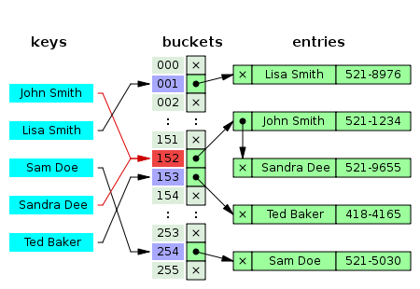
Handling collisions
More common than you think!
Birthday paradox
Example: 1M buckets and 2,450 keys uniformly distributed
95% chance of a collision
Easiest solution is chaining
E.g. with linked lists

Slide 5
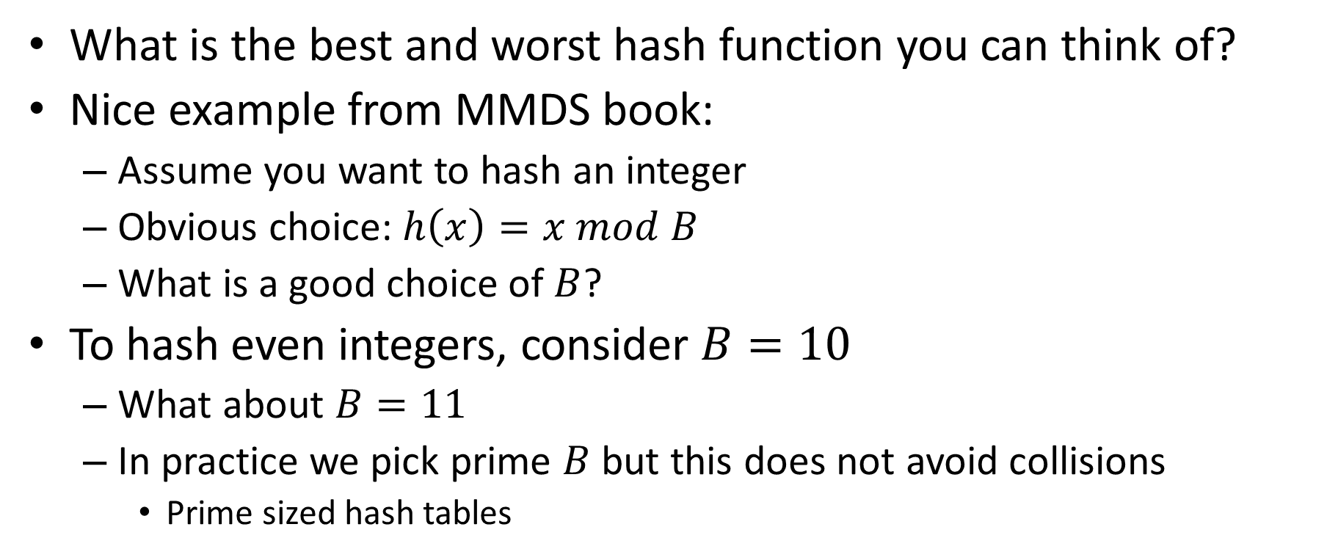
Examples of good and bad hash functions
What is the best and worst hash function you can think of?
Nice example from MMDS book:
Assume you want to hash an integer
Obvious choice: $h\left(x\right)=x mod B$
What is a good choice of $B$?
To hash even integers, consider $B=10$
What about $B=11$
In practice we pick prime $B$but this does not avoid collisions
Prime sized hash tables

Slide 6
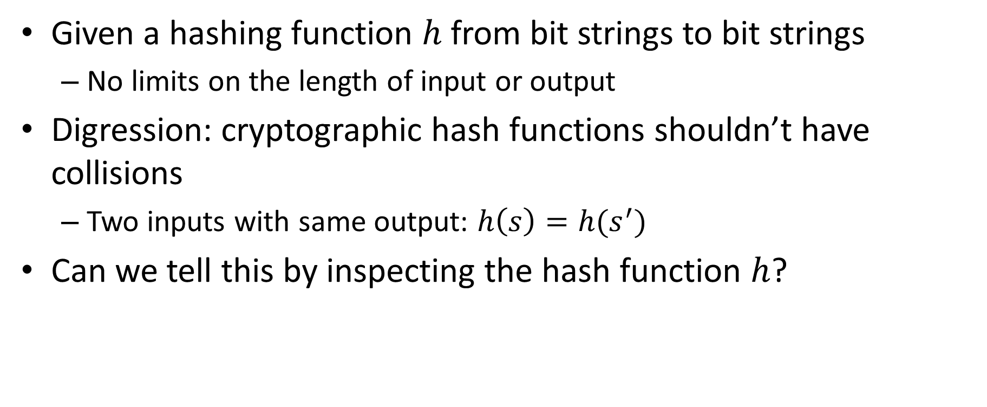
Can you determine if there are collisions?
Given a hashing function $h$ from bit strings to bit strings
No limits on the length of input or output
Digression: cryptographic hash functions shouldn’t have collisions
Two inputs with same output: $h\left(s\right)=h(s^{′})$
Can we tell this by inspecting the hash function $h$?

Slide 7
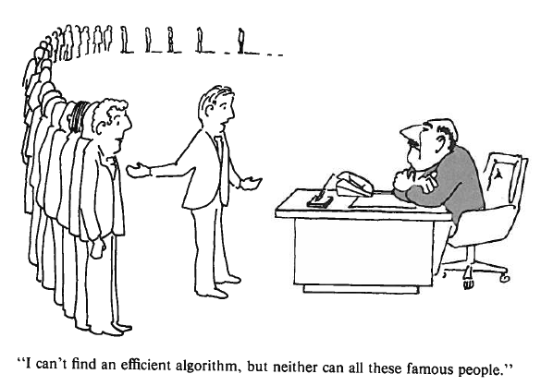
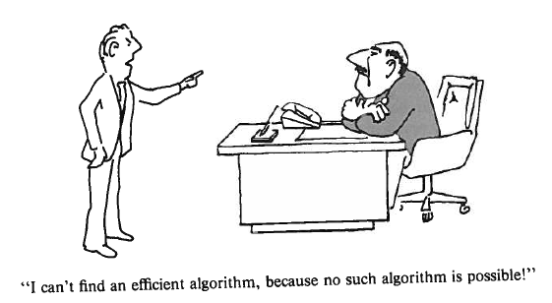
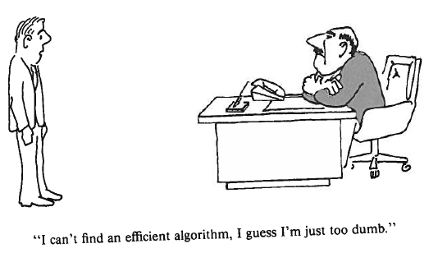
Different excuses for failure
Garey & Johnson, Computers and Intractability

Slide 8
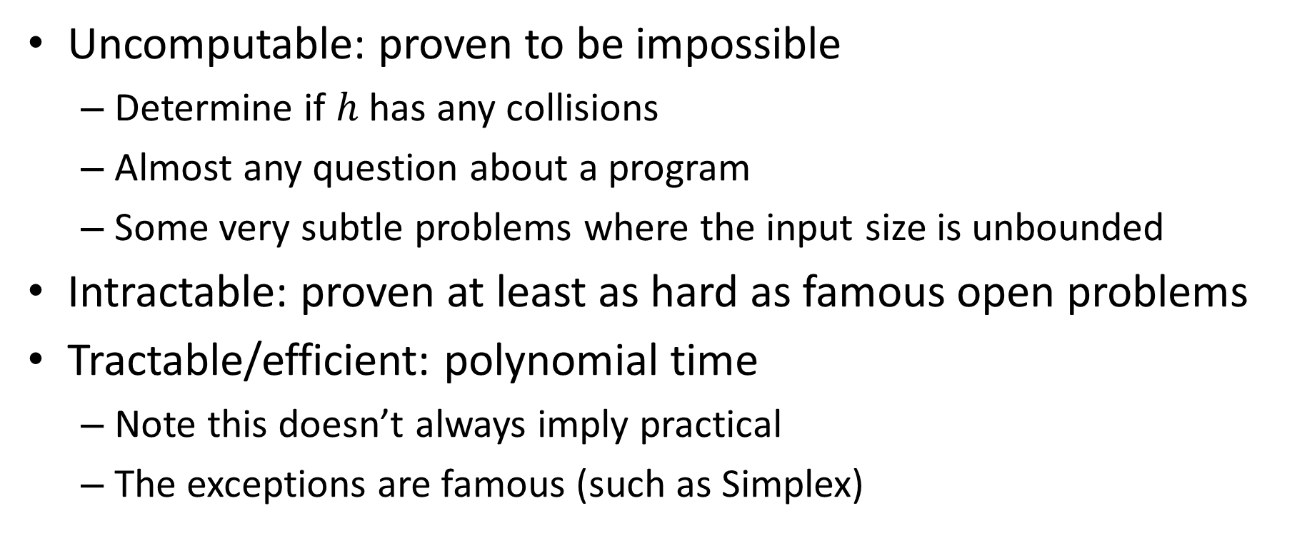
Uncomputable vs intractable
Uncomputable: proven to be impossible
Determine if $h$ has any collisions
Almost any question about a program
Some very subtle problems where the input size is unbounded
Intractable: proven at least as hard as famous open problems
Tractable/efficient: polynomial time
Note this doesn’t always imply practical
The exceptions are famous (such as Simplex)

Slide 9
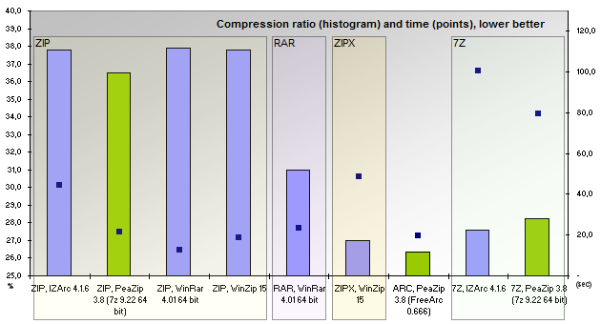
Another difficult program
Suppose you want to write a program like Zip that takes a file and shrinks it (file compression)
Without loss of information, i.e. exactly invertible
Modern compression is pretty good!
Figure source

Slide 10
1. Flajolet-Martin algorithm
Basic idea: the more different elements we see, the more different hash values we will see
We will pick a hash function that spreads out the input elements
Typically uses universal hashing (later this lecture!)

Slide 11
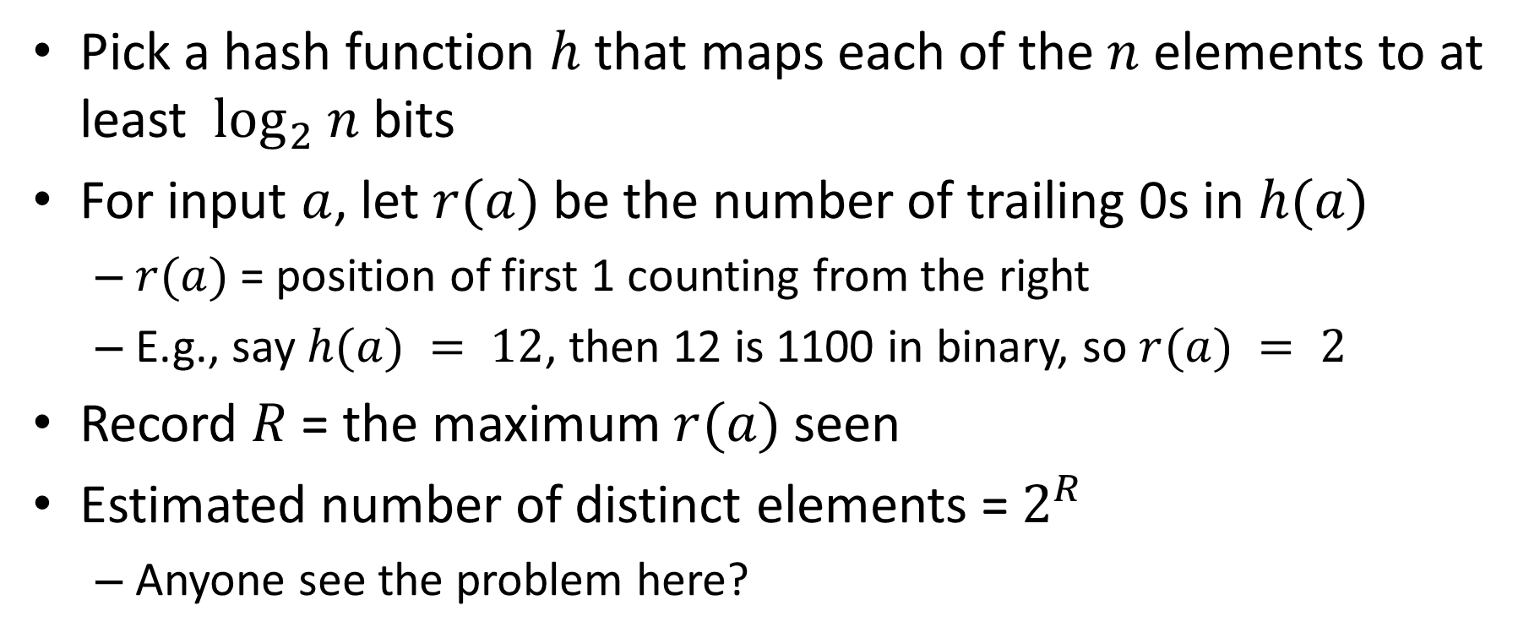
Flajolet-Martin algorithm
Pick a hash function $h$ that maps each of the $n$ elements to at least $\log_{2} n$bits
For input $a$, let $r(a)$be the number of trailing 0s in $h(a)$
$r(a)$= position of first 1 counting from the right
E.g., say $h(a) = 12$, then 12 is 1100 in binary, so $r(a) = 2$
Record $R$ = the maximum $r(a)$seen
Estimated number of distinct elements = $2^{R}$
Anyone see the problem here?

Slide 12
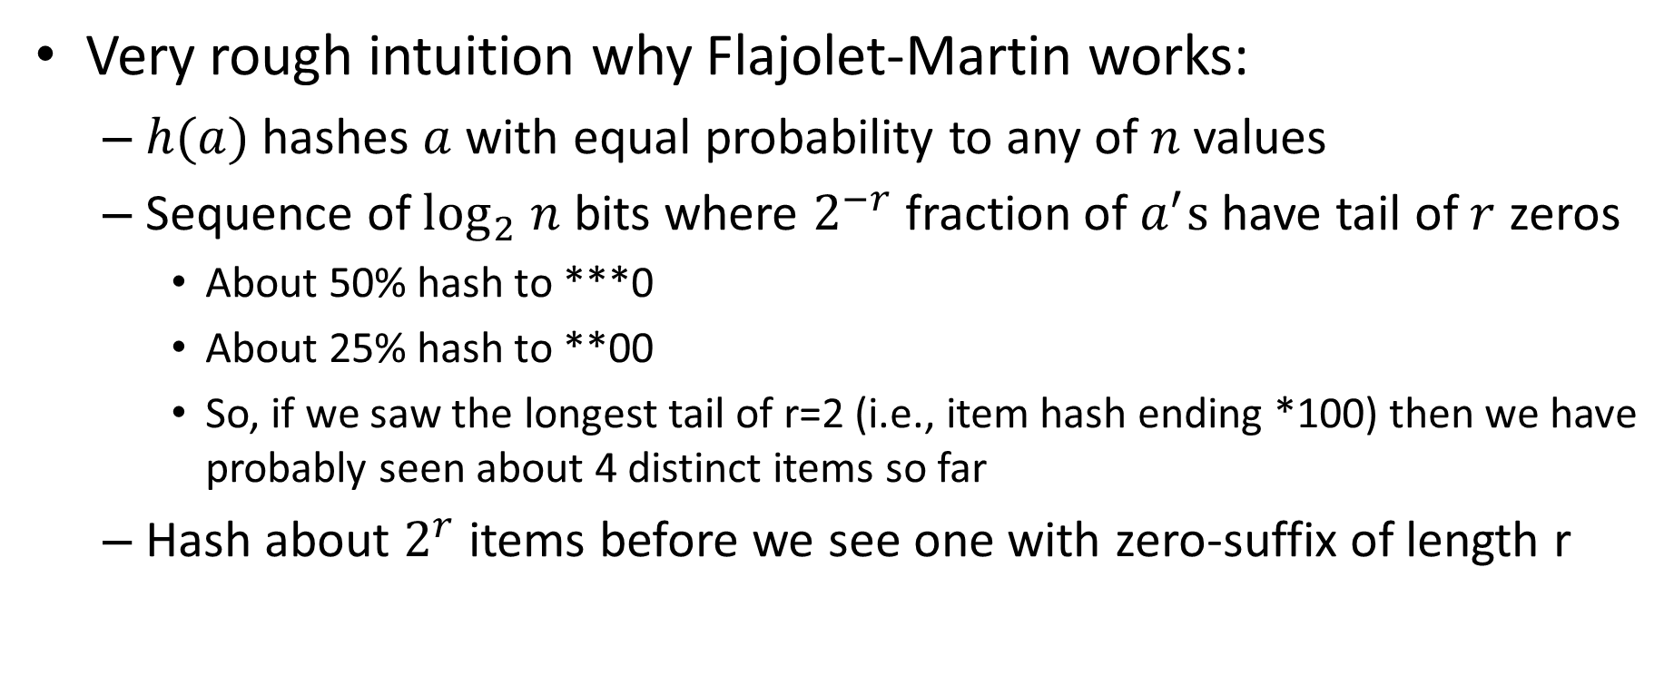
Why It Works: Intuition
Very rough intuition why Flajolet-Martin works:
$h(a)$hashes $a$with equal probability to any of $n$values
Sequence of $\log_{2} n$ bits where $2^{−r}$fraction of $a^{′}s$ have tail of $r$ zeros
About 50% hash to ***0
About 25% hash to **00
So, if we saw the longest tail of r=2 (i.e., item hash ending *100) then we have probably seen about 4 distinct items so far
Hash about $2^{r}$ items before we see one with zero-suffix of length r

Slide 13
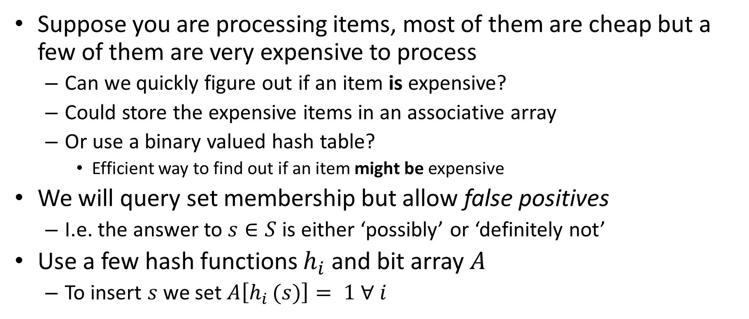
2. Bloom filters
Suppose you are processing items, most of them are cheap but a few of them are very expensive to process
Can we quickly figure out if an item is expensive?
Could store the expensive items in an associative array
Or use a binary valued hash table?
Efficient way to find out if an item might be expensive
We will query set membership but allow false positives
I.e. the answer to $s∈S$ is either ‘possibly’ or ‘definitely not’
Use a few hash functions $h_{i}$ and bit array $A$
To insert $s$ we set $A\left[h_{i }(s)\right]= 1 ∀ i$

Slide 14
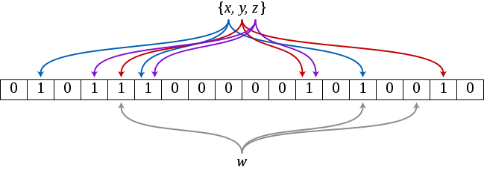

Bloom filter example
Example has 3 hash functions and 18 bit array
$\{x,y,z\}$ are in the set, $w$ is not
Source

Slide 15
Application: web caching
CDN’s, like Akamai, make the web work (~70% of traffic)
About 75% of URL’s are ‘one hit wonders’
Never looked at again by anyone
Let’s not do the work to put these in the disk cache!
Cache on second hit
Use a Bloom filter to record URL’s that have been accessed
A one hit wonder will not be in the Bloom filter
See: Maggs, Bruce M.; Sitaraman, Ramesh K. (July 2015), "Algorithmic nuggets in content delivery" (PDF), SIGCOMM Computer Communication Review, New York, NY, USA,45 (3): 52–66

Slide 16
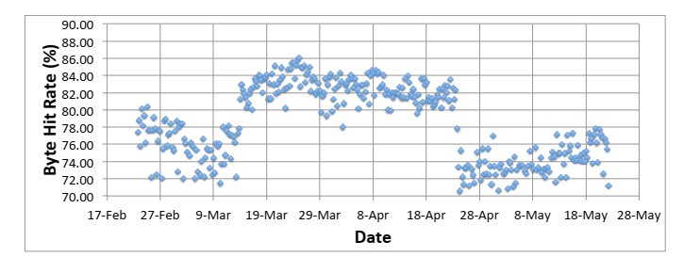
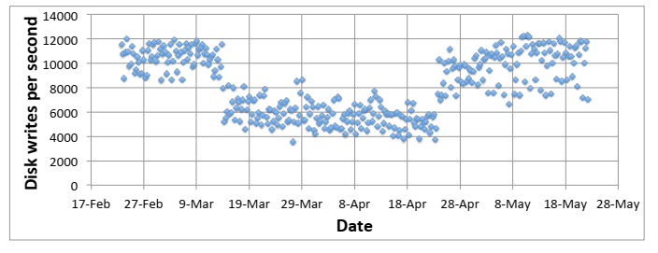
Bloom filters really work!
Figures from: Maggs, Bruce M.; Sitaraman, Ramesh K. (July 2015), "Algorithmic nuggets in content delivery" (PDF), SIGCOMM Computer Communication Review, New York, NY, USA,45 (3): 52–66

Slide 17
Cool facts about Bloom filters
You don’t need to build different hash functions, you can use a single one and divide its output into fields (usually)
Can calculate probability of false positives and keep it low
Time to add an element to the filter, or check if an element is in the filter, is independent of the size of the element (!)
You can estimate the size of the union of two sets from the bitwise OR of their Bloom filters

Slide 18
Perfect & minimal hashing
Choice of hash functions is data-dependent!
Let’s try to hash 4 English words into the buckets 0,1,2,3
E.g., to efficiently compress a sentence
Words: {“banana”, “glib”, “epic”, “food”}
Can efficiently say sentence like “epic glib banana food” = 3,2,1,0
Can you construct a minimal perfect hash function that maps each of these to a different bucket?
Needs to be efficient, not (e.g.) a list of cases

Slide 19
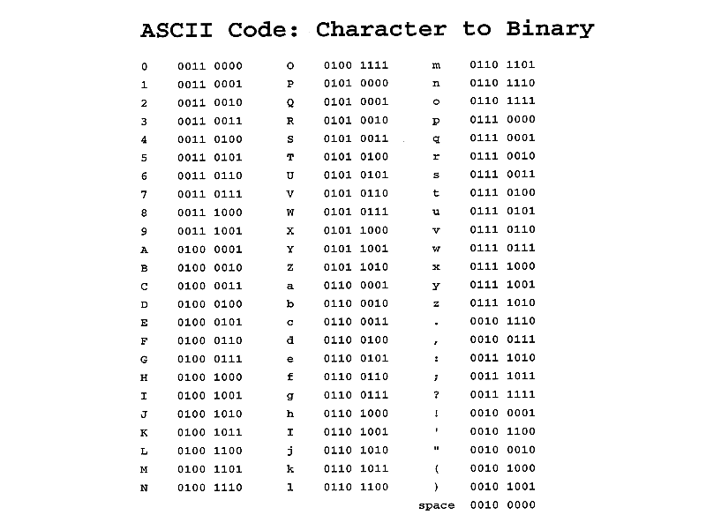
Perfect hashing example
For this particular example, it is easy

Slide 20
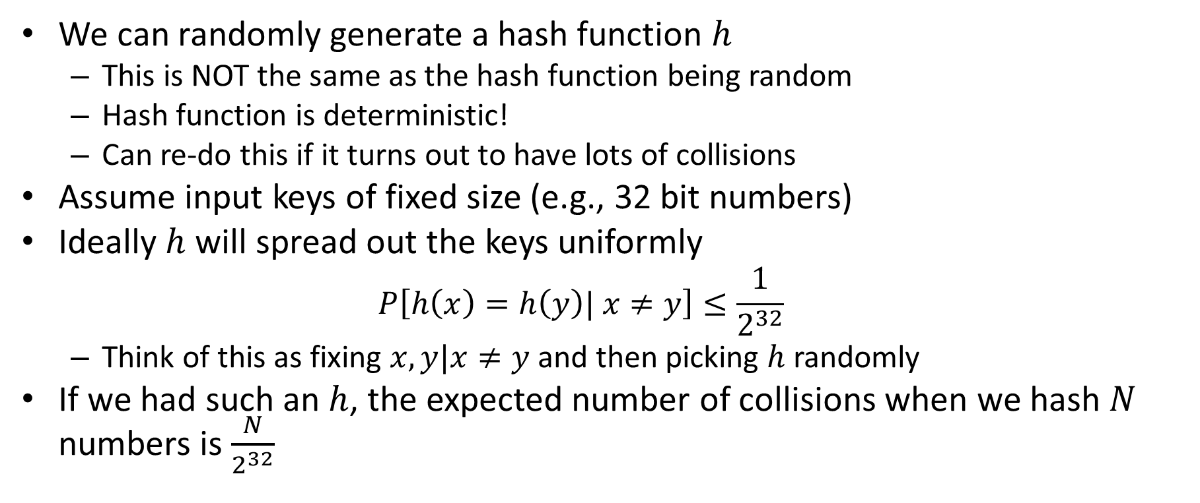
Universal hashing
We can randomly generate a hash function $h$
This is NOT the same as the hash function being random
Hash function is deterministic!
Can re-do this if it turns out to have lots of collisions
Assume input keys of fixed size (e.g., 32 bit numbers)
Ideally $h$ will spread out the keys uniformly
$$P\left[h\left(x\right)=h\left(y\right)| x≠y\right]≤\frac{1}{2^{32}}$$
Think of this as fixing $x,y|x≠y$and then picking $h$randomly
If we had such an $h$, the expected number of collisions when we hash $N$ numbers is $\frac{N}{2^{32}}$

Slide 21
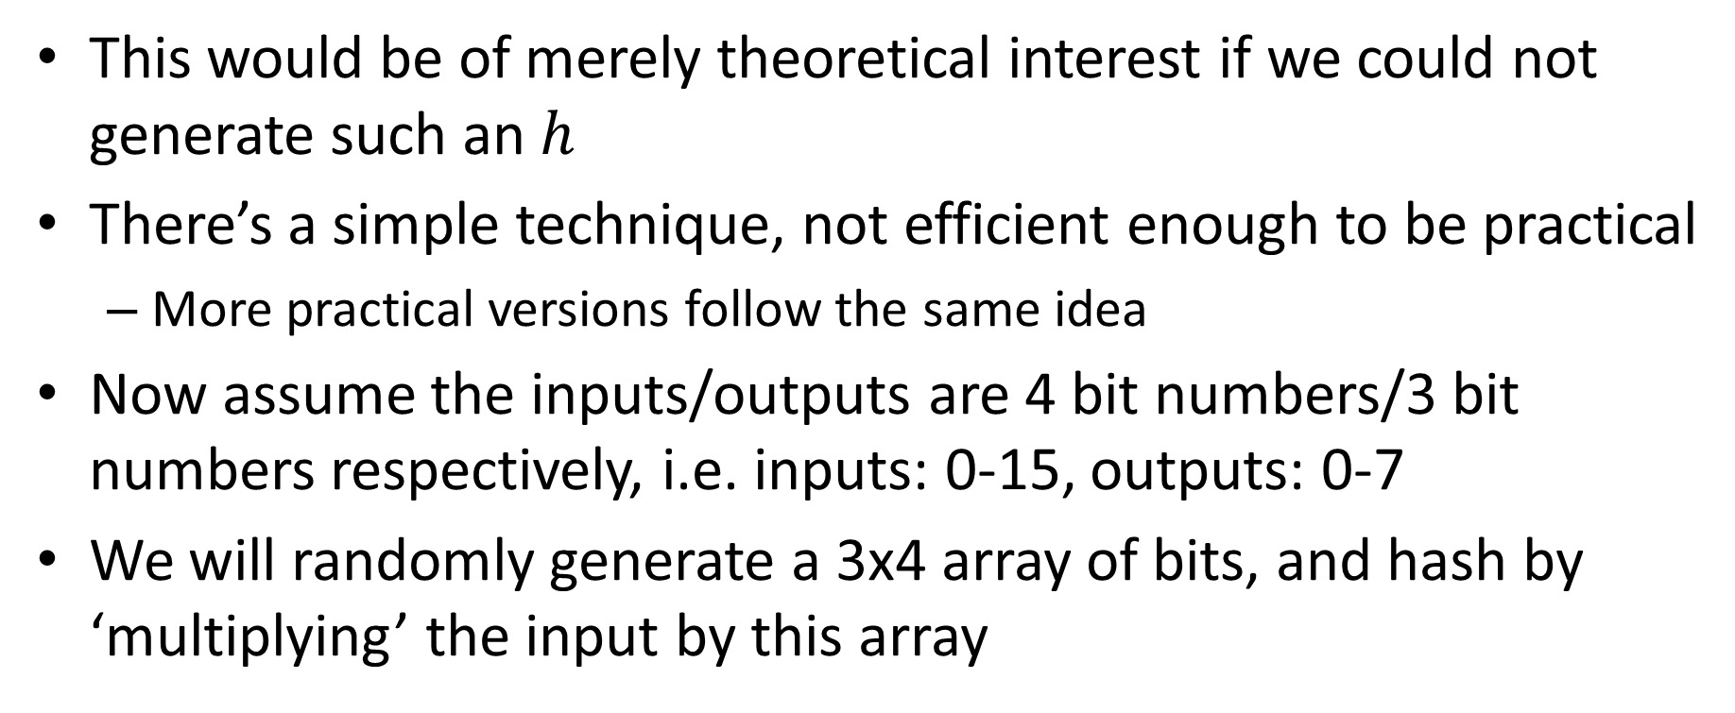
Universal hashing by matrix multiplication
This would be of merely theoretical interest if we could not generate such an $h$
There’s a simple technique, not efficient enough to be practical
More practical versions follow the same idea
Now assume the inputs/outputs are 4 bit numbers/3 bit numbers respectively, i.e. inputs: 0-15, outputs: 0-7
We will randomly generate a 3x4 array of bits, and hash by ‘multiplying’ the input by this array

Slide 22
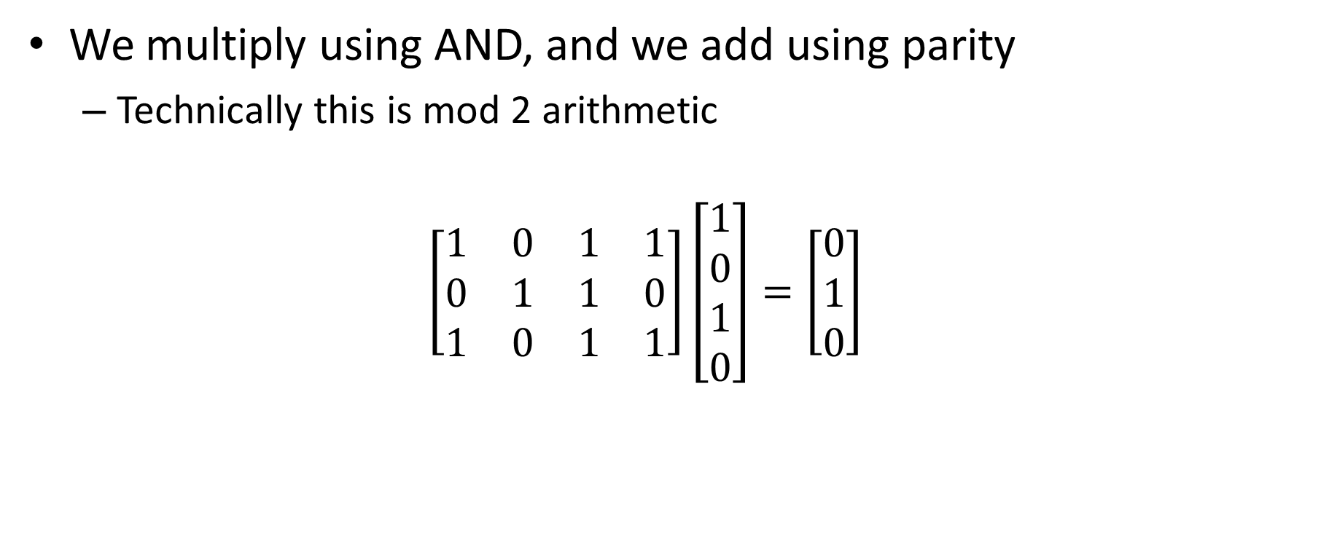
Universal hashing example
We multiply using AND, and we add using parity
Technically this is mod 2 arithmetic
$$\left[\begin{matrix}1 & 0 & 1 & 1 \\ 0 & 1 & 1 & 0 \\ 1 & 0 & 1 & 1\end{matrix}\right]\left[\begin{matrix}1 \\ 0 \\ 1 \\ 0\end{matrix}\right]=\left[\begin{matrix}0 \\ 1 \\ 0\end{matrix}\right]$$

Slide 23
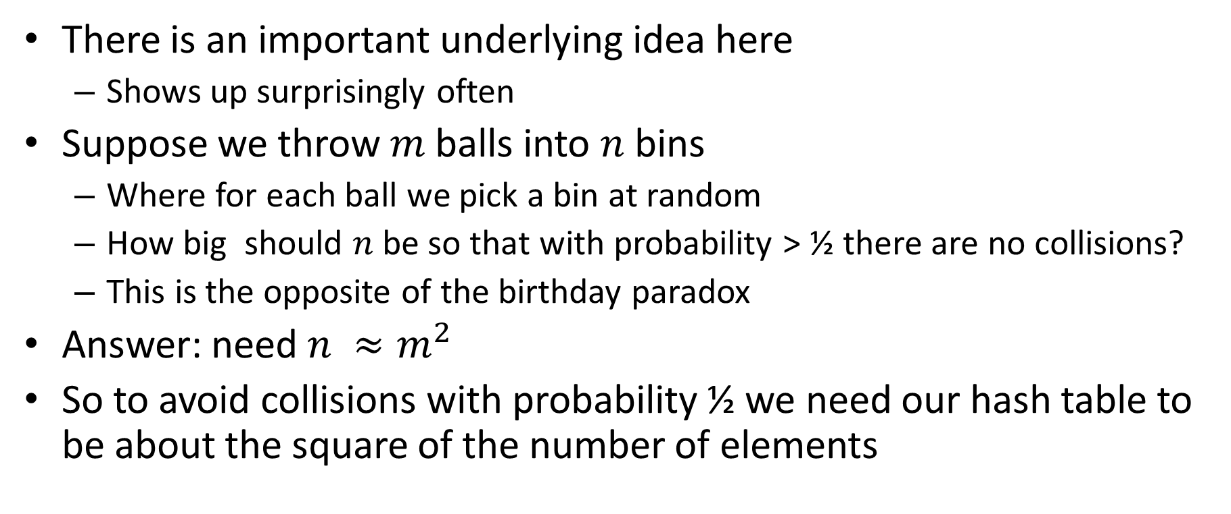
Balls into bins
There is an important underlying idea here
Shows up surprisingly often
Suppose we throw $m$balls into $n$ bins
Where for each ball we pick a bin at random
How big should $n$be so that with probability > ½ there are no collisions?
This is the opposite of the birthday paradox
Answer: need $n ≈m^{2}$
So to avoid collisions with probability ½ we need our hash table to be about the square of the number of elements

Slide 24
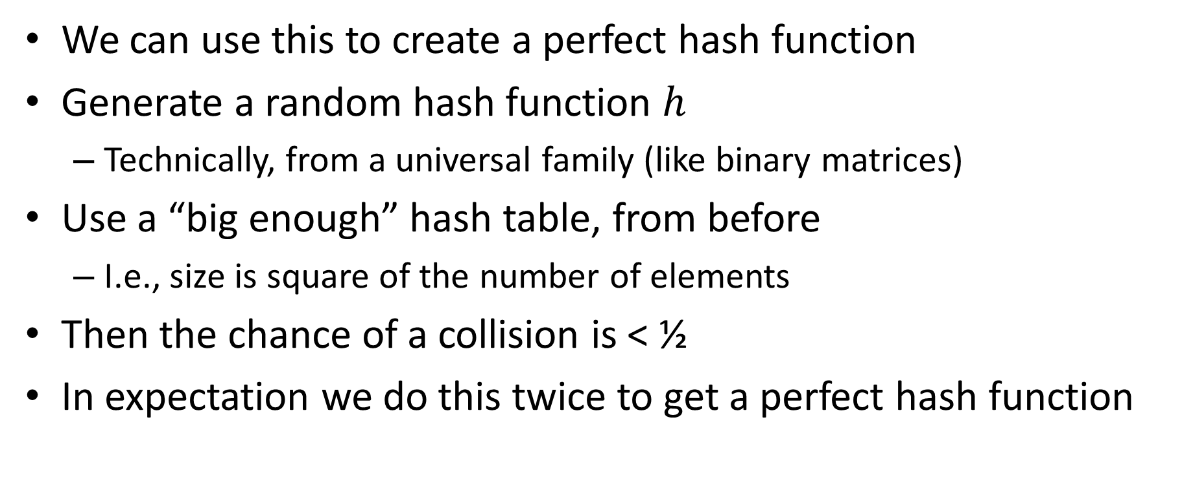
Perfect hashing from universal hashing
We can use this to create a perfect hash function
Generate a random hash function $h$
Technically, from a universal family (like binary matrices)
Use a “big enough” hash table, from before
I.e., size is square of the number of elements
Then the chance of a collision is < ½
In expectation we do this twice to get a perfect hash function

Slide 25
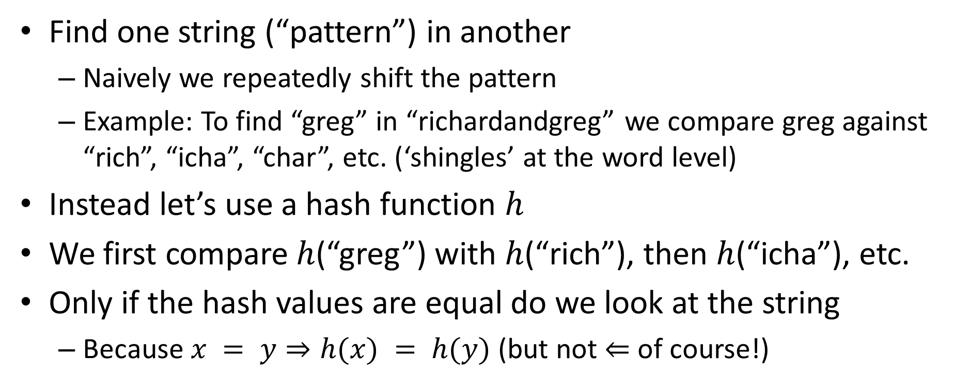
Rabin-Karp string search
Find one string (“pattern”) in another
Naively we repeatedly shift the pattern
Example: To find “greg” in “richardandgreg” we compare greg against “rich”, “icha”, “char”, etc. (‘shingles’ at the word level)
Instead let’s use a hash function $h$
We first compare $h$(“greg”) with $h$(“rich”), then $h$(“icha”), etc.
Only if the hash values are equal do we look at the string
Because $x = y⇒h(x) = h(y)$ (but not $⇐$ of course!)

Slide 26
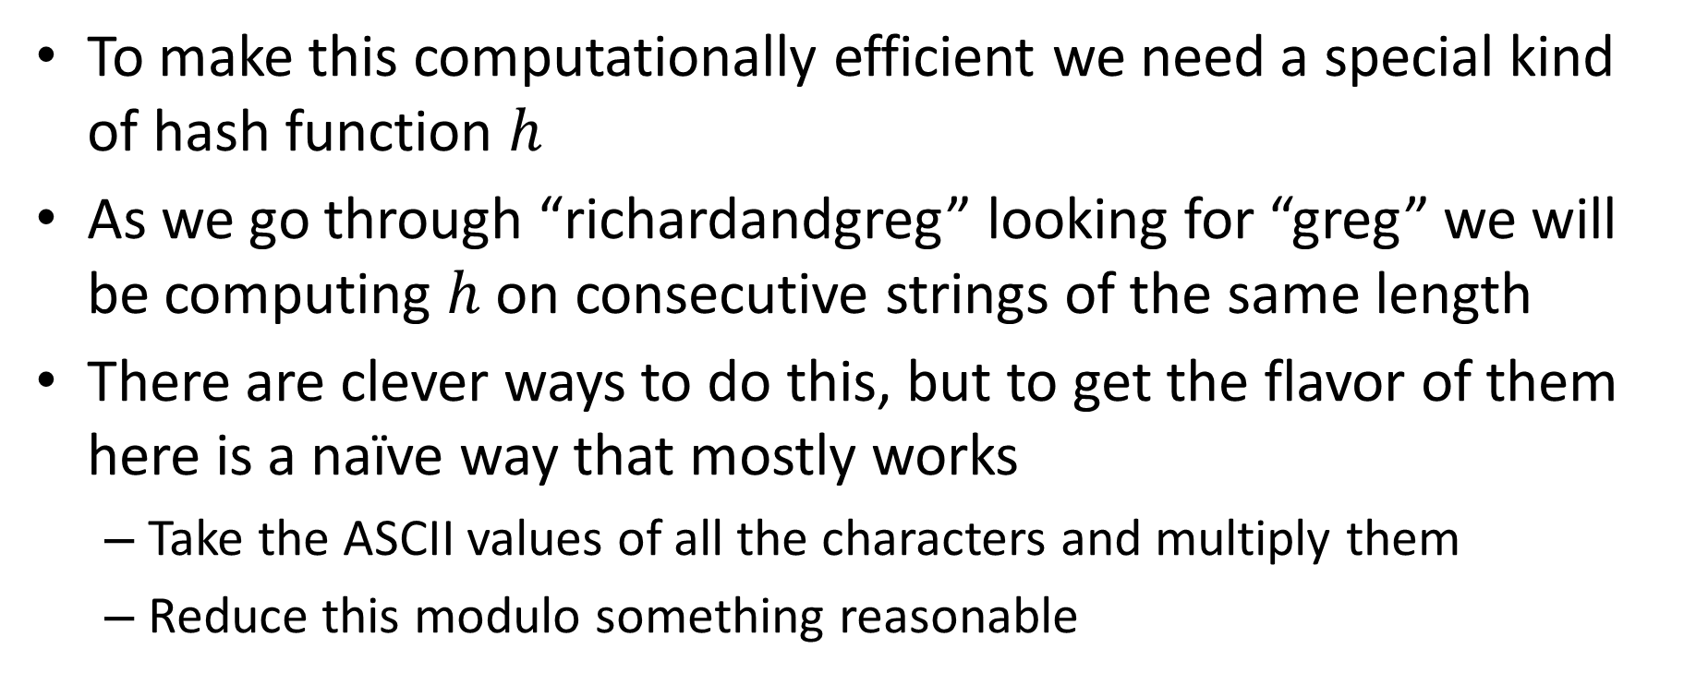
Rolling hash functions
To make this computationally efficient we need a special kind of hash function $h$
As we go through “richardandgreg” looking for “greg” we will be computing $h$ on consecutive strings of the same length
There are clever ways to do this, but to get the flavor of them here is a naïve way that mostly works
Take the ASCII values of all the characters and multiply them
Reduce this modulo something reasonable

